Slide 1
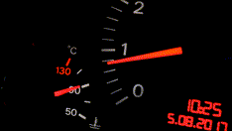
Measurement Paradigms
Dr Oliver Clark (Oli)
Featuring Zigmund Farrow-Manfred the Cat

Slide 2
This Video
Ways of measuring
Item Response Theory
Classical Test Theory (basic intro)

Slide 3
Data Types (Recap)
Nominal
Ordinal
Scaler
Interval
Ratio
Faster > Slower
Big > Medium > Small
First > Second > Third

Slide 4
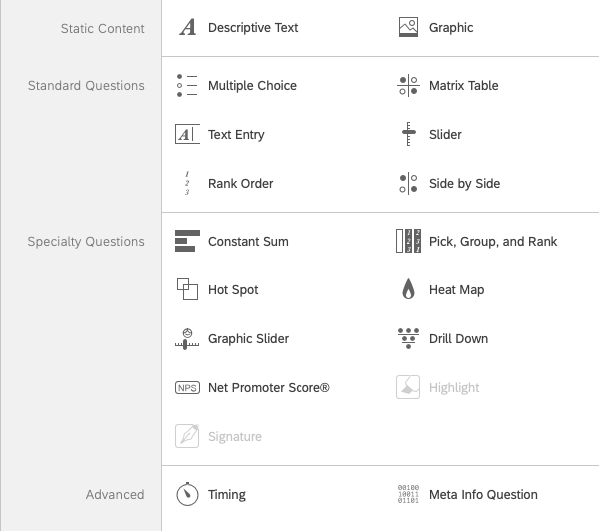
Ways of Measuring
Likert
VAS
Line Bisection
Ranking

Slide 5
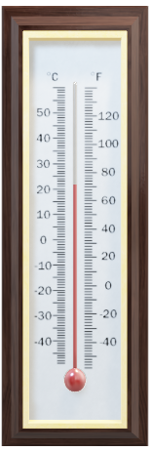
Scores
Item Response Theory (aka Latent Trait Theory)
Classica Test Theory

Slide 6
Item Response Theory
Difficulty of the question
Probability that someone will get the question right
Strength of the attribute
Probability that someone will rate themselves higher

Slide 7
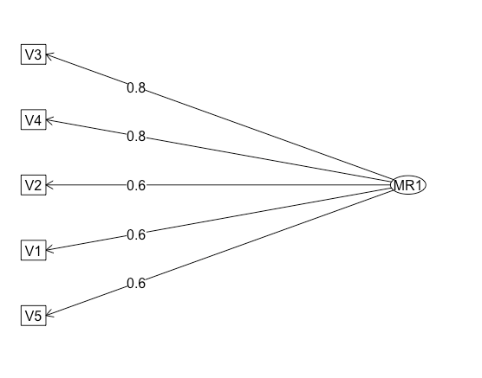
Item Response Theory
Latent Trait
T

Slide 8
Classical Test Theory
True Score Theory
Outcome is a sum or mean of total responses
Answer is called the ‘Observed Score’

Slide 9
Classical Test Theory
➕
➕
T
➕
➕
=Observed Score
= (“TRUE SCORE” + ERROR)

Slide 10
Measurement Paradigms
Classical Test Theory | Item Response Theory
+ Easier to communicate | + Accounts for difficulty
+ Can be calculated by hand | + Accounts for individual questions
+ Provides a range of scores | + Independent of items
- Variation assumed to be the same between individuals | - Complex to communicate

